Slide 1
Buck EEPROM Test A1.2
20160412
value

Slide 2
Revision history
time | author | comment
160226 | value | Initial draft (landers board solution)
160229 | value | IA Control board solution
160412 | value | Add dut IIC drvice

Slide 3
Solution1
MAC mini
已经确认不用读取DUT的iic device 160416
Usb cable
IIC BUS1
buck EEPROM
USB to Uart
ARM
DUT IIC device
IIC BUS2
Buck
DUT
IA Control board
1:Need to provide DUT IIC Device communication protocol.

Slide 4
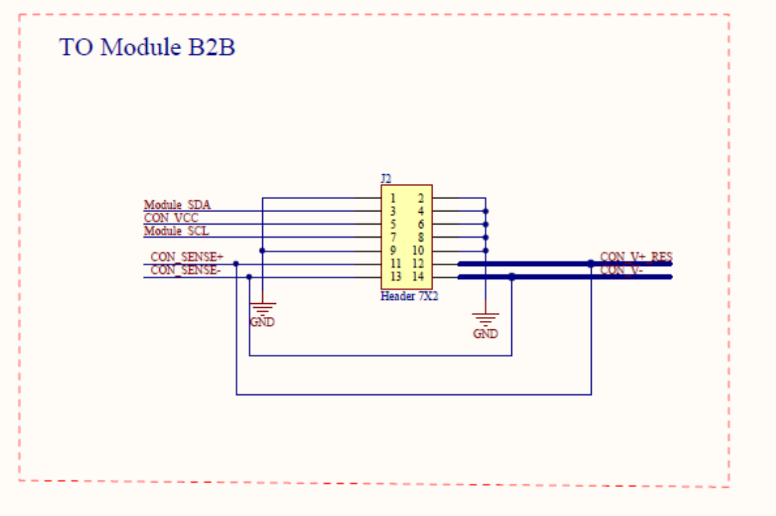
DUT interface
Whether or not to drive the CON_SENSE+,CON_SENSE-,CON_V+RES, CON_V- Signal?

Slide 5
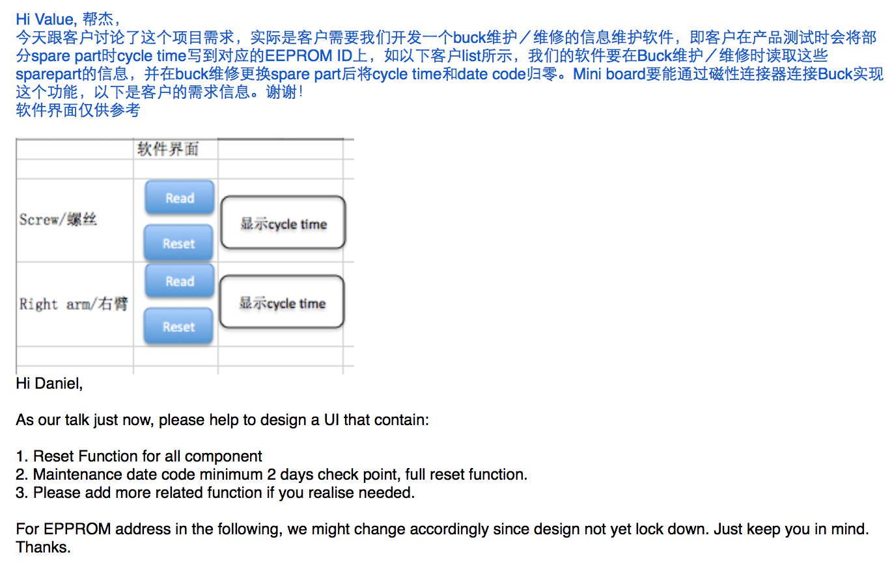
Customer provide 1

Slide 6
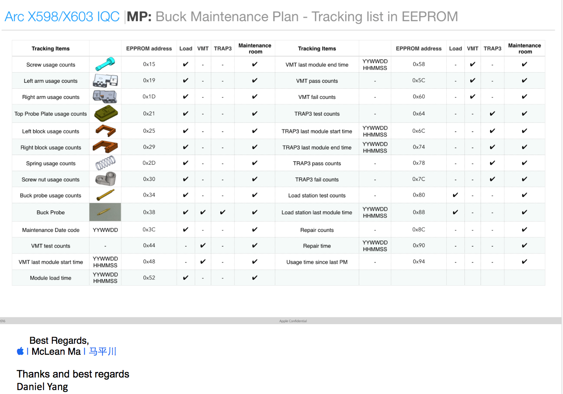
Customer provide 2

Slide 7
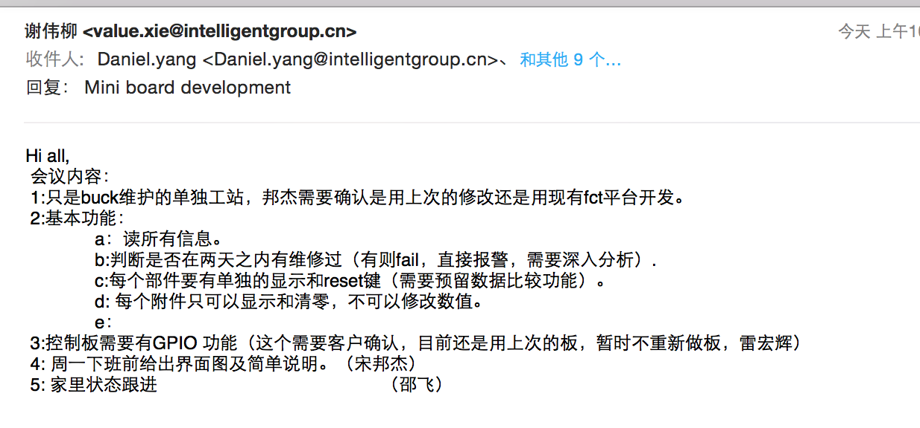
Customer provide 2

